Slide 1

VeriTrust AI
Privacy‑First Adaptive Identity Trust Framework for Banking
PSB Hackathon Series 2026
Team Name: AI Nexus
Team Members: Somesh Kumar Singh(Team Leader)
Email:someshsingh2206@gmail.com
Continuous Identity Validation for Secure Digital Banking

Slide 2

Problem Statement
Challenges in Digital Banking:
Current Threat Landscape
Account Takeover (ATO) through stolen credentials
Fake KYC and onboarding fraud
Unauthorized account recovery attempts
Insider misuse of customer data
New device and suspicious login risks
Behavioral anomalies indicating compromised accounts
Existing Limitation
Authentication occurs only at login
Limited continuous monitoring
Excessive OTP usage causes poor user experience

Slide 3

Our Solution – VeriTrust AI
Privacy-First Adaptive Identity Trust Framework
VeriTrust AI continuously evaluates the trustworthiness of customers, employees, and devices across banking channels using real-time risk assessment.
Key Solution Highlights:
Continuous identity verification instead of one-time authentication.
Dynamic Trust Score generated for every login, transaction, and account recovery request.
AI-powered behavioral analytics to detect unusual user activities.
Device fingerprinting to identify trusted and suspicious devices.
Risk-based authentication that triggers OTP or additional verification only when necessary.
Insider threat monitoring for detecting misuse of privileged access.
Real-time fraud detection to prevent account takeover and KYC fraud.
Privacy-first architecture with minimal data collection and secure processing.

Slide 4
System architecture
Frontend- Banking Portal , Security Dashboard
Backend Services-Risk Scoring Engine , Risk Scoring Engine
Device Trust Service , Behavioral Analytics Engine
Fraud Detection Service , Insider Threat Service
Infrastructure
Spring Boot APIs
MongoDB
Kafka
Python ML Services
Output
Trust Score
Risk Level
Verification Decision
Customer/Employee
│
▼
Banking Portal
│
▼
VeriTrustAI Gateway
│
┌──────┼─────────┐
▼ ▼ ▼
Device Behavior Fraud
Trust Engine Detection
│
▼
Risk Scoring Engine
│
┌──────┼─────────┐
▼ ▼ ▼
Allow OTP Face Verification
│
▼
Banking Backend
.

Slide 5
Workflow
Step 1: User performs: Login , Transaction , Account Recovery
Step 2: System collects: Device Information, IP Address , Location, Browser Details,
Behavioral Signals
Step 3:
Trust Score | Action
80-100 | Allow
50-79 | OTP
20-49 | Face Verification
Below 20 | Block

Slide 6
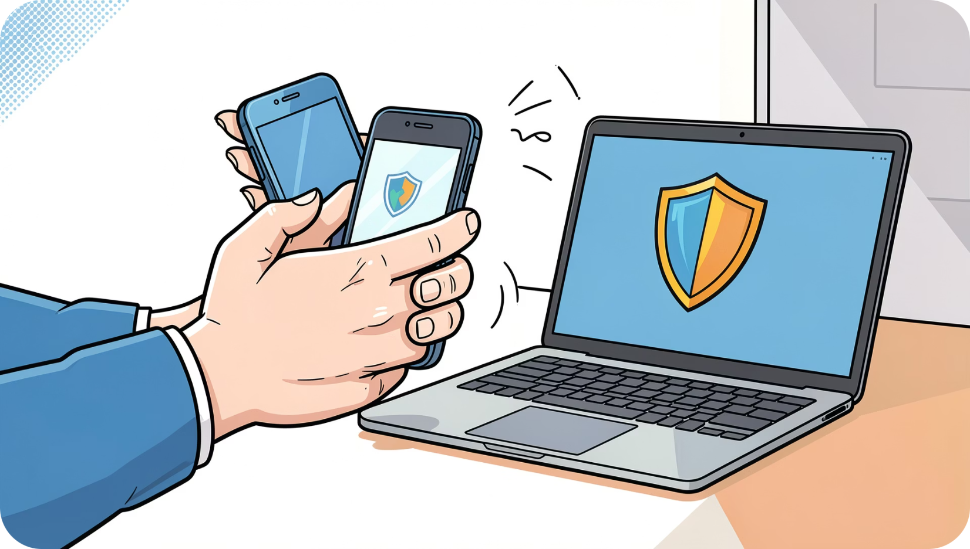
Key features
Device Trust
Behavioral Analytics
Trust scoring for endpoints, jailbreak/root detection, and provenance checks.
Continuous profiling: typing cadence, navigation patterns, transaction behavior.
Fraud Detection
Insider Threat Detection
Real‑time anomaly detection and rule enrichment to catch KYC and payment fraud.
Baselines for privileged users, alerting on deviations and suspicious exports.

Slide 7

AI & data models
Datasets used to train and validate models — representative, anonymized where required, and augmented for rare events:
Modeling strategy:
Isolation Forest
PaySim dataset (simulated payments)
(https://www.kaggle.com/datasets/ealaxi/paysim1)
Credit Card Fraud dataset (transaction fraud patterns)
(https://www.kaggle.com/datasets/mlg-ulb/creditcardfraud)
User Behavior & Login Detection Dataset
Purpose:
Behavioral anomaly detection, suspicious logins, and identity trust scoring.
(https://www.kaggle.com/datasets/iamsouravbanerjee/customer- shopping-trends-dataset)
Unsupervised anomaly detection for novel behavior and device anomalies.
Random Forest
Robust classification for labeled fraud cases and explainability needs.
XGBoost
High-performance scoring for transaction risk with feature importance outputs.

Slide 8
Technology stack
Platform layers
Frontend
React.js, Tailwind CSS
Backend
Spring Boot, Spring Security, JWT
Database
MongoDB
Python, Scikit‑Learn, XGBoost
AI/ML
Messaging
Apache Kafka
Deployment
Docker, Kubernetes, Render,Vercel
Designed for scalability, low latency, and secure orchestration of policy decisions.

Slide 9

Expected outcomes
Reduce account takeover incidents
Early detection of stolen credentials and session anomalies — fewer fraudulent logins.
Prevent KYC fraud
Layered identity signals increase onboarding accuracy and reduce synthetic accounts.
Detect insider threats
Behavioral baselines for staff limit lateral movement and unauthorized access.
Improve digital trust & UX
Adaptive friction keeps genuine customers moving while blocking risky actions.

Slide 10

Impact & future scope
Lower fraud losses through proactive, continuous detection
Better customer experience via risk‑based, minimal friction
Stronger regulatory posture with auditable policy decisions
Future scope
Deepfake detection for biometric and video verification
Graph‑based fraud analysis to surface coordinated rings
Federated learning to share models across institutions while preserving privacy
"Building continuous trust in digital banking"

